Slide 1

Portable Digital Storage Oscilloscope (DSO) Project
Presented by : Gopanandhan P D
Yazin Faisal
Sebin Sibichan

Slide 2
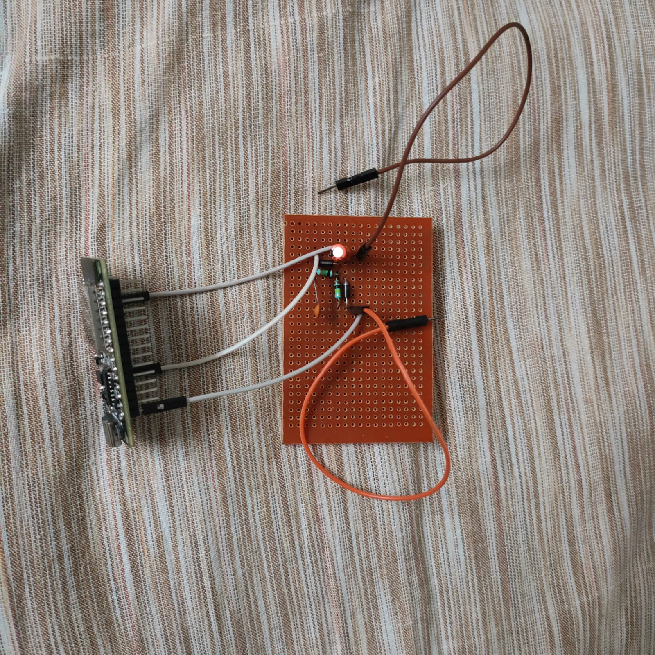
Abstract
• What is a DSO?
• Why build a portable version?
• Goals: Low-cost, DIY oscilloscope for students and hobbyists

Slide 3
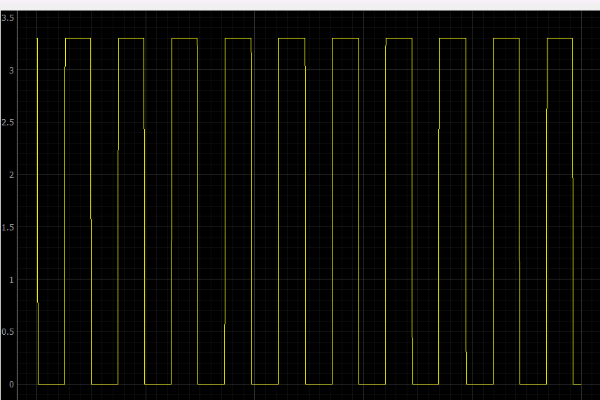
Objectives
• Real-time signal monitoring
• Affordable and portable solution
• Educational use for students
• Debugging/testing circuits

Slide 4
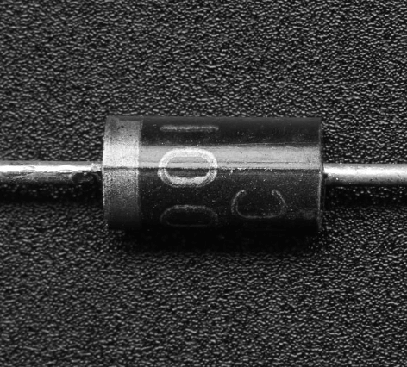
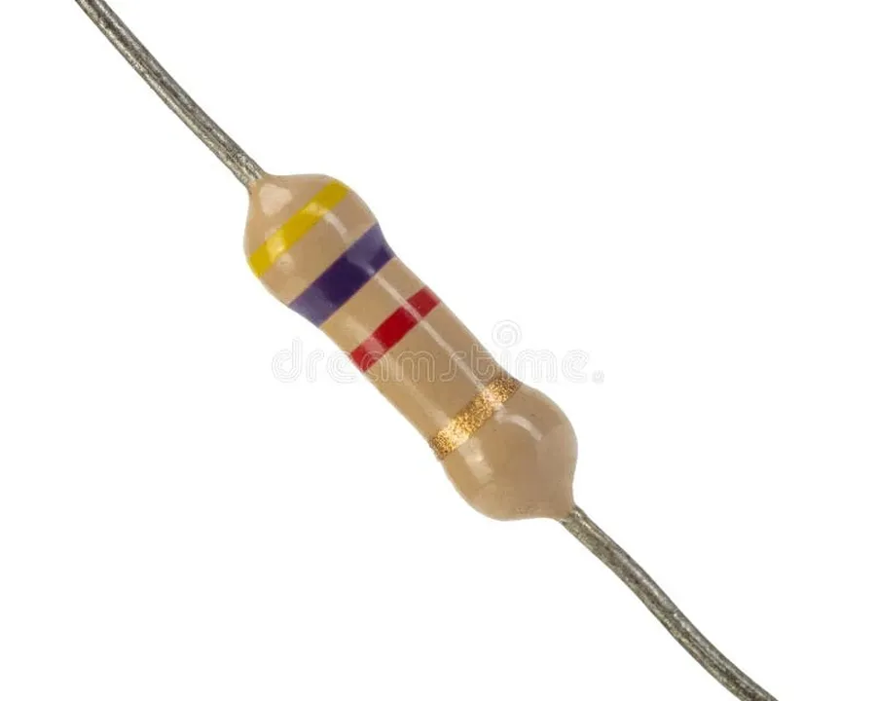
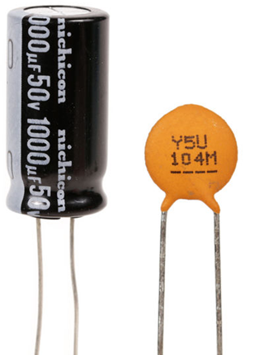
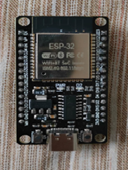
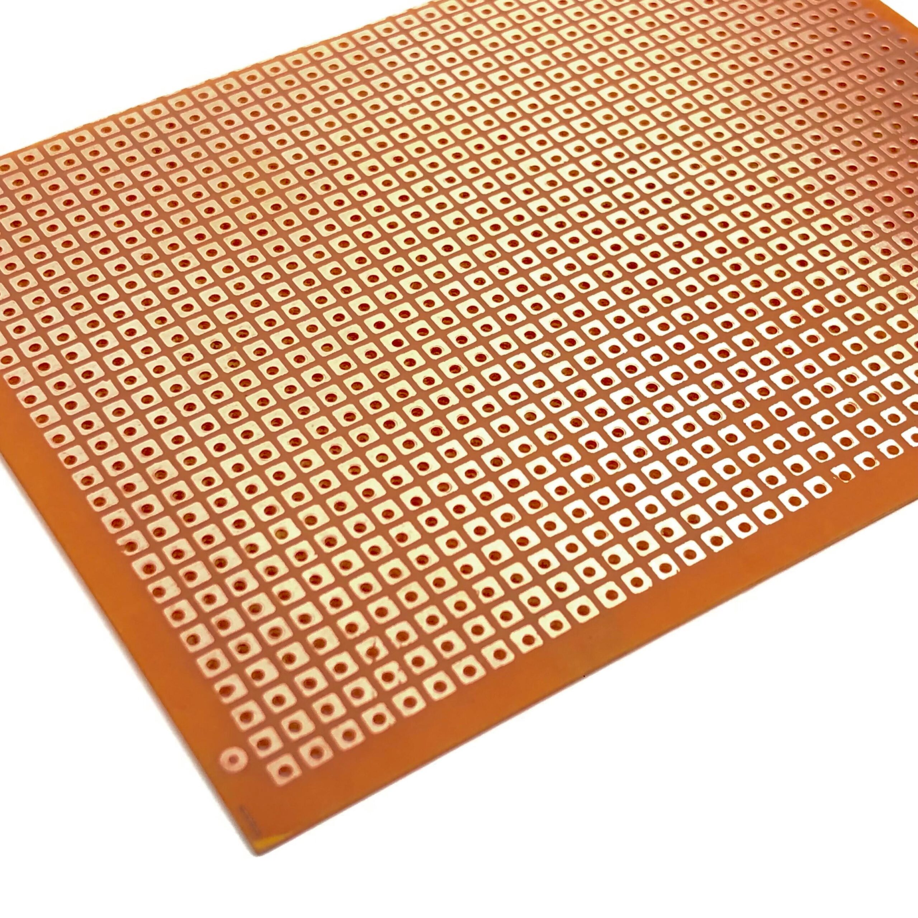
Major Components
• ESP32 Development Board (12-bit ADC, Wi-Fi/Bluetooth)
• Resistors (100kΩ)
• Capacitors (10µF, 100nF)
• Diodes (general-purpose)
• PCB + Power supply (3.3V)
• Signal source (sine wave input)
Monitor(Laptop)

Slide 5
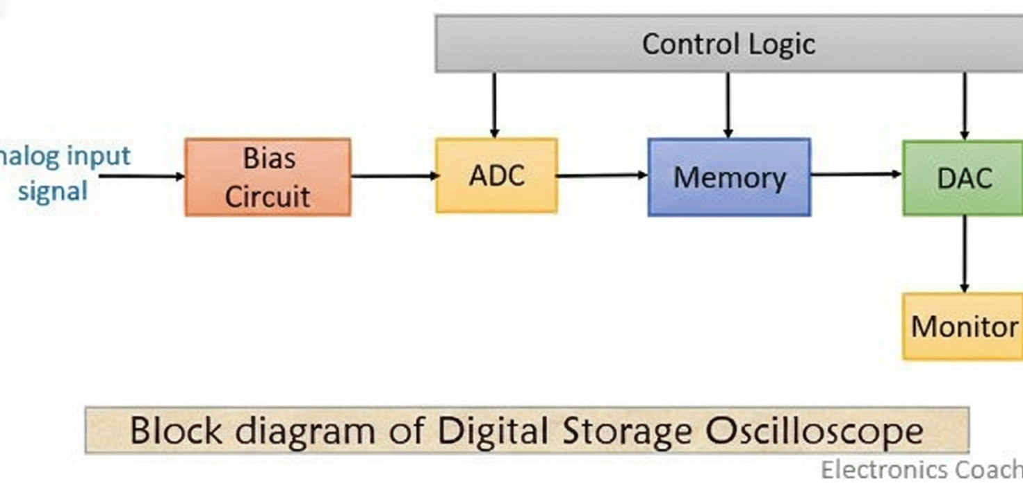

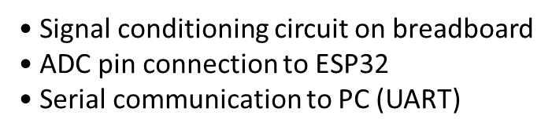


Working Principle
• ESP32 samples analog signals at 10 kHz
• Sends data via serial to PC
• Python GUI plots waveform and
calculates Vpp, frequency

Slide 6
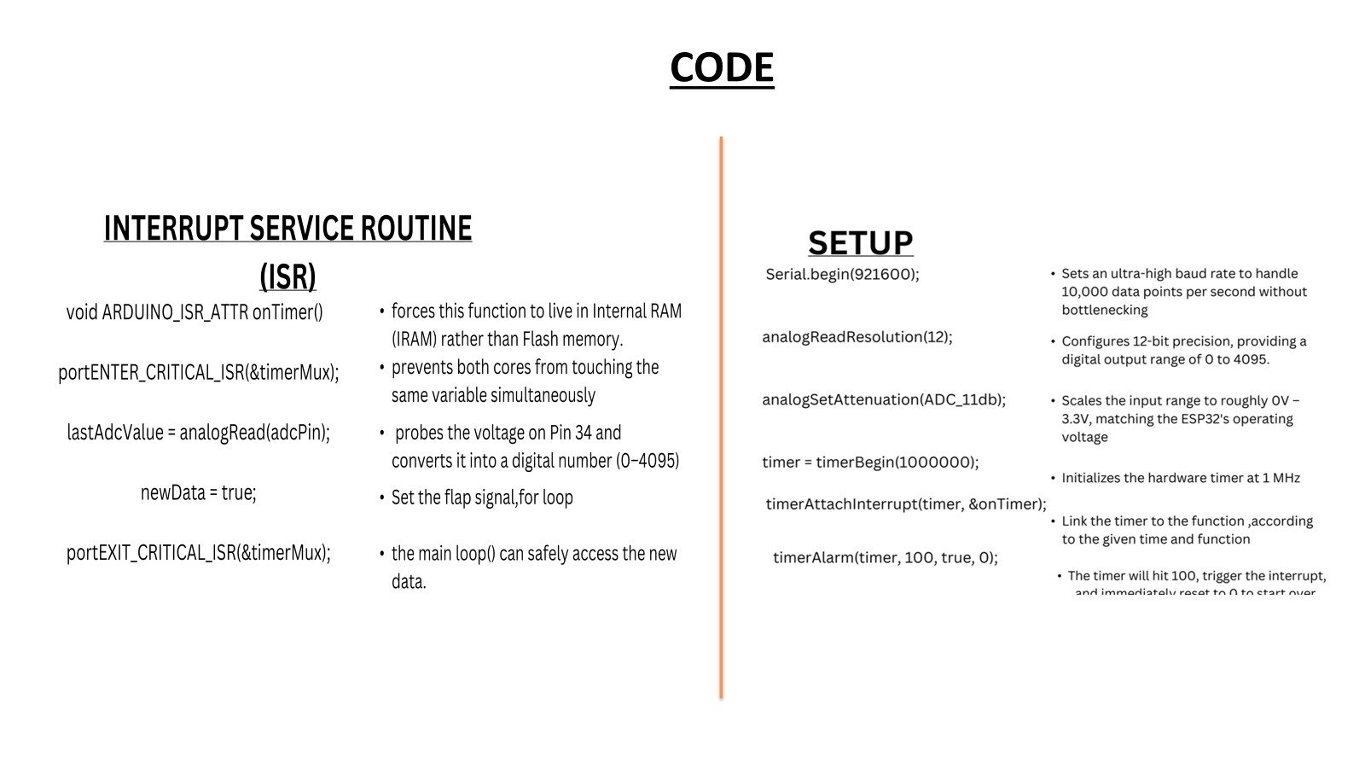

Slide 7
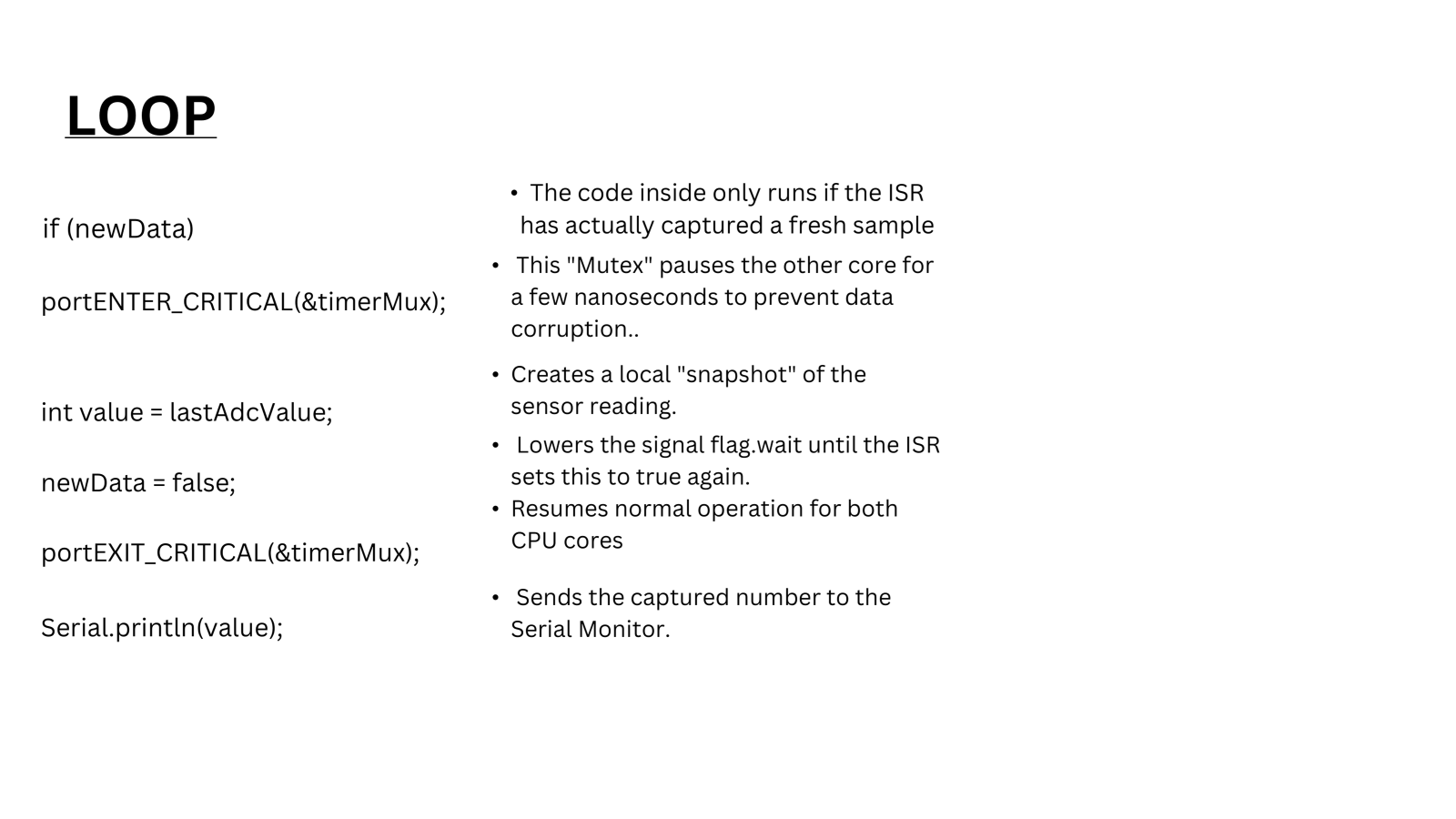

Slide 8
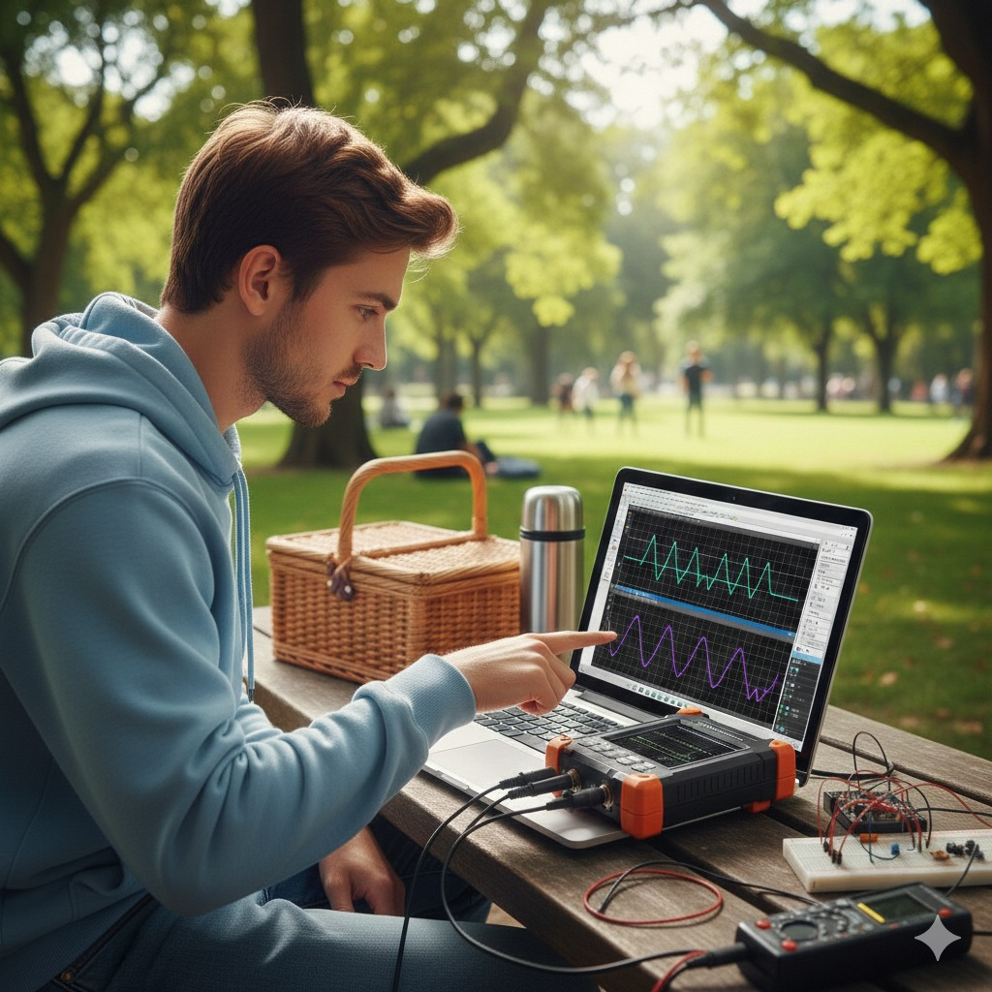

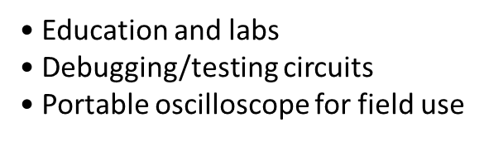
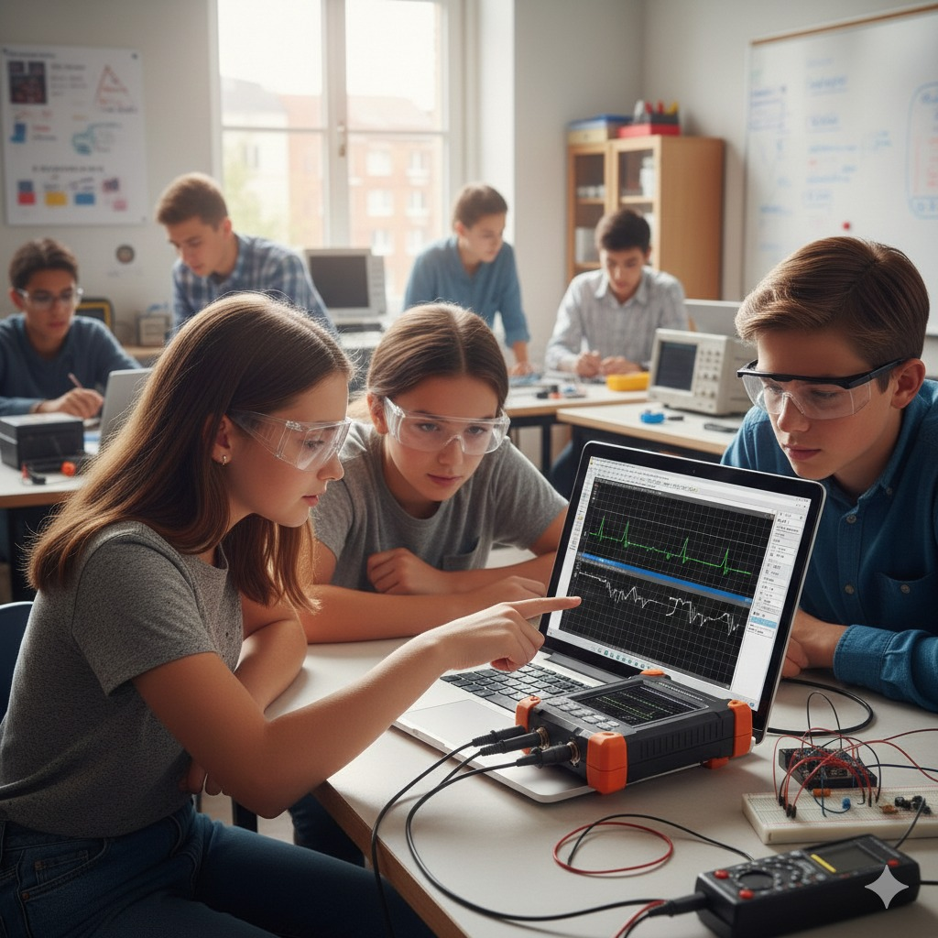


Features
• Real-time waveform plotting
• High-speed sampling (10 kHz)
• Portable and affordable solution
• Measurements: Vpp, Frequency estimation

Slide 9
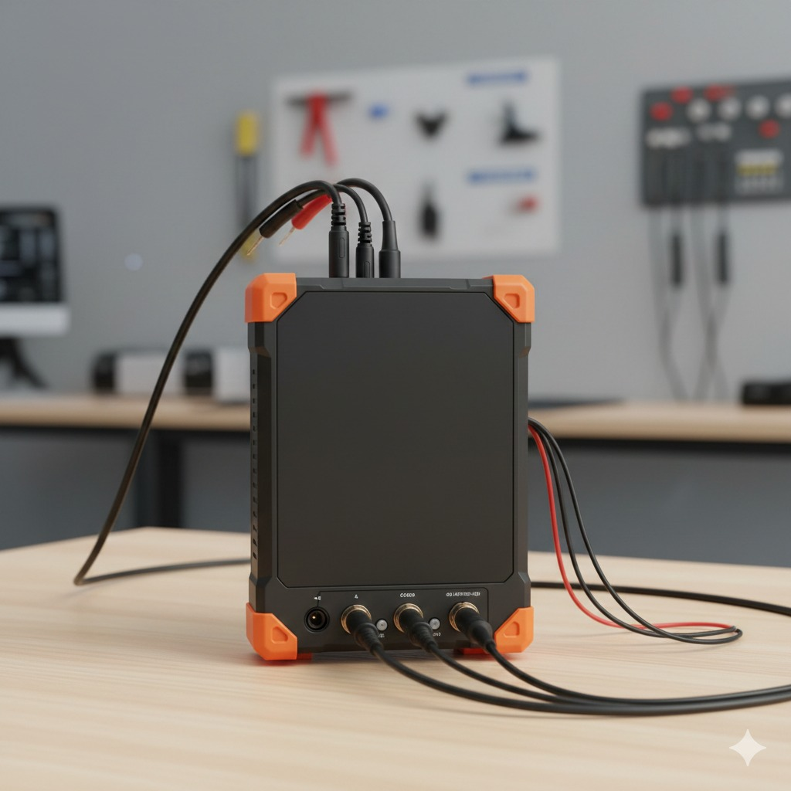
Future Improvements
• Higher sampling rate (Upto 500KHz wave reading)
• RMS, duty cycle measurements
• Data logging/export
• Multi-channel GUI support

Slide 10
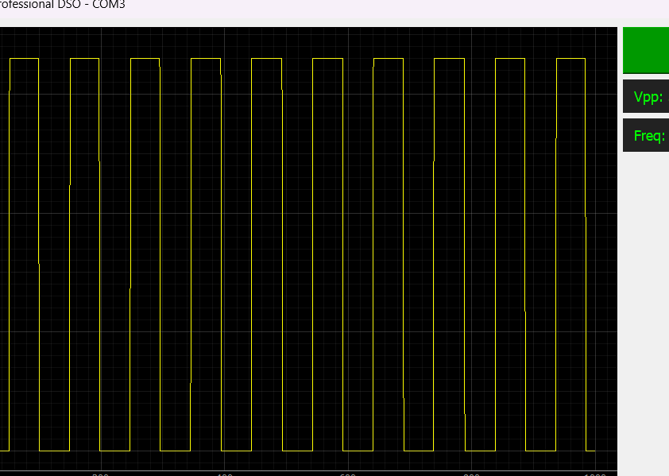
Results
• Waveform displayed in GUI
• Vpp and frequency calculated

Slide 11
Conclusion
• Portable DSO successfully demonstrated
• Combines hardware + software for signal visualization
• Affordable DSOs

